Slide 1

Data Science For Business
January 2025
Module 5 – Model Assessment

Slide 2
Quiz time!

Slide 3
Quiz discussion!

Slide 4
Q1
What is the primary difference between L1 and L2 regularization?
 | L1 regularization penalizes the sum of weights, L2 penalizes the sum of squared weights.
 | L2 regularization penalizes the sum of weights, L1 penalizes the sum of squared weights.
 | L1 regularization penalizes the sum of absolute value of the weights, L2 penalizes the sum of squared weights.
 | L2 regularization penalizes the sum of absolute value of the weights, L1 penalizes the sum of squared weights.

Slide 5
Q1
What is the primary difference between L1 and L2 regularization?
 | L1 regularization penalizes the sum of weights, L2 penalizes the sum of squared weights.
 | L2 regularization penalizes the sum of weights, L1 penalizes the sum of squared weights.
 | L1 regularization penalizes the sum of absolute value of the weights, L2 penalizes the sum of squared weights.
 | L2 regularization penalizes the sum of absolute value of the weights, L1 penalizes the sum of squared weights.

Slide 6
Q2
What is the purpose of regularization in logistic regression?
 | To increase the complexity of the model.
 | To ensure the model fits the training data perfectly.
 | To penalize complex models and reduce overfitting.
 | To avoid using nonlinear features.

Slide 7
Q2
What is the purpose of regularization in logistic regression?
 | To increase the complexity of the model.
 | To ensure the model fits the training data perfectly.
 | To penalize complex models and reduce overfitting.
 | To avoid using nonlinear features.

Slide 8
Q3
In linear/polynomial regression, we can increase the degree of the model to increase the complexity. We can also increase complexity by
 | increasing regularization on the model in the training process
 | decreasing regularization on the model in the training process

Slide 9
Q3
In linear/polynomial regression, we can increase the degree of the model to increase the complexity. We can also increase complexity by
 | increasing regularization on the model in the training process
 | decreasing regularization on the model in the training process

Slide 10
Q4
Describe the difference between a fitting curve and a learning curve. What is on the x and y axis for each? You can write this in bullet point format.

Slide 11
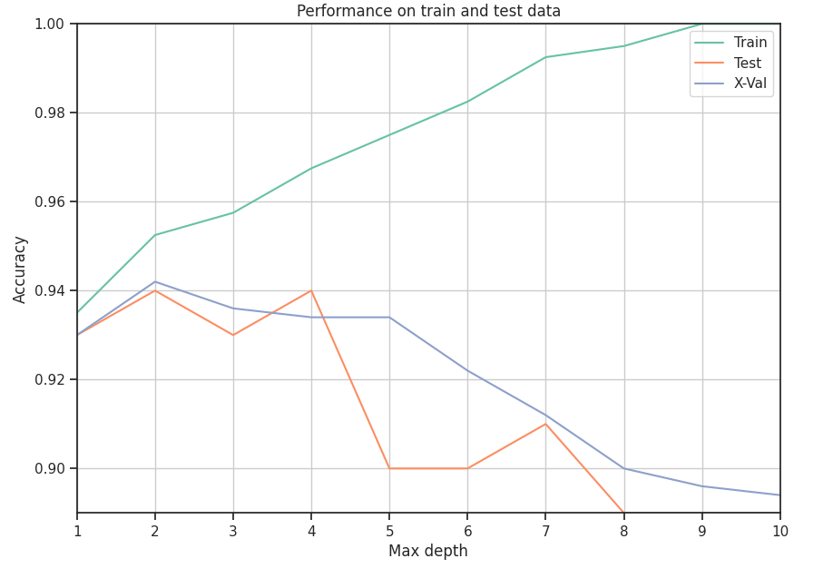
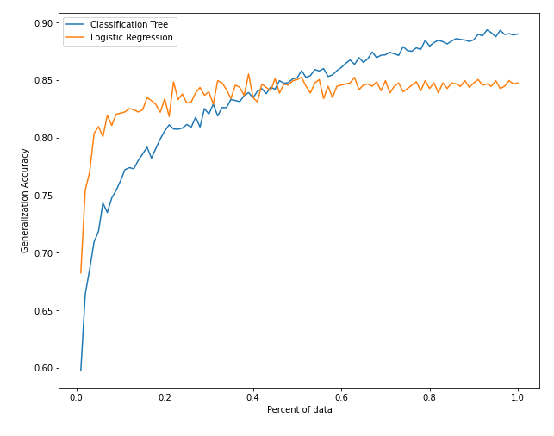
Q4
Describe the difference between a fitting curve and a learning curve. What is on the x and y axis for each? You can write this in bullet point format.
Fitting Curve
Learning Curve
Model Complexity
Percent of Data

Slide 12
Q5
You are tasked with building a model to predict whether a new type of concrete mixture will achieve a compressive strength of 35 MPa or more. Your dataset contains multiple features, such as the quantities of cement, water, and aggregate, and you observe that some features have values ranging from 0 to 1, while others range from 0 to 1000. You have information on the target variable. Your boss wants you to create a decision tree to model concrete strength. Unfortunately, the standard regularization approach of penalizing weights cannot be applied to decision tress because they are not directly minimizing a loss function/maximizing an objective function. How might you ensure that this decision tree does not overfit the training data?

Slide 13
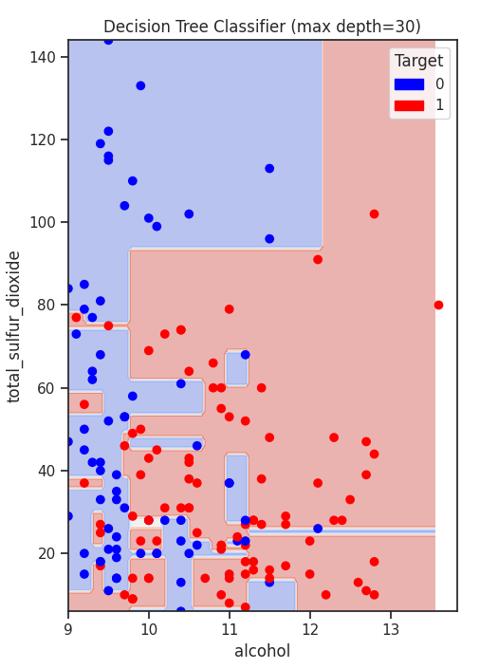
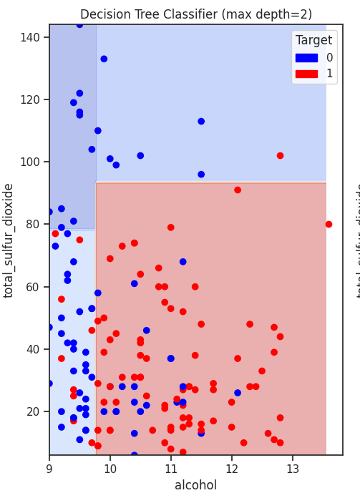
Q5
You are tasked with building a model to predict whether a new type of concrete mixture will achieve a compressive strength of 35 MPa or more. Your dataset contains multiple features, such as the quantities of cement, water, and aggregate, and you observe that some features have values ranging from 0 to 1, while others range from 0 to 1000. You have information on the target variable. Your boss wants you to create a decision tree to model concrete strength. Unfortunately, the standard regularization approach of penalizing weights cannot be applied to decision tress because they are not directly minimizing a loss function/maximizing an objective function. How might you ensure that this decision tree does not overfit the training data?
Limit depth of tree (potentially by enforcing a minimum number of samples per leaf)

Slide 14
Agenda
Week 1
Module 1 (Thursday): Intro to data science + Python for DS
Module 2 (Friday): Intro to supervised learning
Week 2
Module 3 (Monday): Fitting models, generalization
Module 4 (Tuesday): Regularization
Module 5 (Wednesday): Evaluation (ROC, cost visualization)
Module 6 (Thursday): Modeling text data
Week 3
Module 7 (Monday): Neural networks, GenAI
Module 8 (Tuesday): Guest lecture(s)
Module 9 (Wednesday): Causal inference, AB testing, wrap up
Final Exam (Thursday)

Slide 15
Agenda
Week 1
Module 1 (Thursday): Intro to data science + Python for DS
Module 2 (Friday): Intro to supervised learning
Week 2
Module 3 (Monday): Fitting models, generalization
Module 4 (Tuesday): Regularization
Module 5 (Wednesday): Evaluation (ROC, cost visualization)
Module 6 (Thursday): Modeling text data
Week 3
Module 7 (Monday): Neural networks, GenAI
Module 8 (Tuesday): Guest lecture(s)
Module 9 (Wednesday): Causal inference, AB testing, wrap up
Final Exam (Thursday)
Core Toolkit

Slide 16
Agenda
Week 1
Module 1 (Thursday): Intro to data science + Python for DS
Module 2 (Friday): Intro to supervised learning
Week 2
Module 3 (Monday): Fitting models, generalization
Module 4 (Tuesday): Regularization
Module 5 (Wednesday): Evaluation (ROC, cost visualization)
Module 6 (Thursday): Modeling text data
Week 3
Module 7 (Monday): Neural networks, GenAI
Module 8 (Tuesday): Guest lecture(s)
Module 9 (Wednesday): Causal inference, AB testing, wrap up
Final Exam (Thursday)
Core Toolkit
Other Models/ Applications

Slide 17
Grading notes
Assignment 2 may not be graded until this weekend
I’m trying to get a grader to speed this up!
Otherwise, all grades should be in so far – please let me know if not!

Slide 18
Feedback
Thank you all for your feedback!
A summary of many of the main ideas:
A little more break time
Live coding is good, but slow it down
Polls
Group work is helpful

Slide 19

Group discussion!
Specifically, your task is to help Henrietta devise a precise, step-by-step plan for how the analyst/tech team should use MegaTelCo’s vast data resource to decide which customers to target with the special retention offer prior to them paying off their phones.
Be specific as to what data to use and how to use them, and specifically how the team should decide on the set of customers to target to best reduce churn for a particular incentive budget. Use your better judgment as to what data MegaTelco would have.
Henrietta, a Data Science Product Manager, has just joined MegaTelCo, one of the largest telecommunication firms. MegaTelco is having a major problem with churn in their wireless business. In the mid-Atlantic region, 20% of cell-phone customers leave when their phones are paid off, and it is getting increasingly difficult to acquire new customers. They call her in to help understand the problem and devise a solution. Marketing has designed a special retention offer.
So: Where should we start?

Slide 20
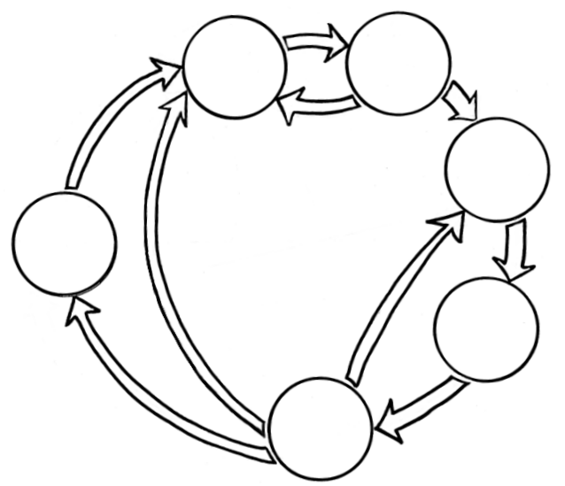
Where we are
Business Understanding
Data Understanding
So far
Data Preparation
Data Science
Process
Deployment
Modeling
Evaluation

Slide 21

Where we are
Business Understanding
Data Understanding
So far
Clearly define the problem:
We want to identify customers who are likely to leave
Key DS problem types (so far):
Data Preparation
Data Science
Process
Deployment
Supervised Learning
Modeling
Classification / Probability Estimation
Regression
Evaluation

Slide 22
Where we are
Business Understanding
Data Understanding
So far
What data do we have – is it actually informative of the thing we care about (churn)?
Even if we don’t know, we can EVALUATE and see!
Data Preparation
Data Science
Process
Deployment
Modeling
Evaluation

Slide 23
Where we are
Business Understanding
Data Understanding
So far
Convert binary variables into 1/0
Normalize/standardize data (generally a good idea, necessary if we’re doing regularization)
We need target and features
Instances in training data need to be the same as instances we’ll use at inference time
Break data up into train and test sets (for evaluation later!)
Data Preparation
Data Science
Process
Deployment
Modeling
Evaluation

Slide 24
Where we are
Business Understanding
Data Understanding
So far
Convert binary variables into 1/0
Normalize/standardize data (generally a good idea, necessary if we’re doing regularization)
We need target and features
Instances in training data need to be the same as instances we’ll use at inference time
Break data up into train and test sets (for evaluation later!)
Data Preparation
Data Science
Process
Deployment
Modeling
Tomorrow: we’ll talk about if the data is text data!
Evaluation

Slide 25
Where we are
Business Understanding
Data Understanding
So far
Supervised Learning
Data Preparation
Data Science
Process
Classification / Probability Estimation
Decision tree
Linear/ polynomial logistic regression
Deployment
Regression
Modeling
Linear/polynomial regression
Regression tree
Evaluation

Slide 26
Where we are
Business Understanding
Data Understanding
So far
Supervised Learning
Data Preparation
Data Science
Process
Classification / Probability Estimation
Divides up feature space based on entropy
Decision tree
Linear/ polynomial logistic regression
Deployment
Regression
Modeling
Linear/polynomial regression
Regression tree
Evaluation

Slide 27
Where we are
Business Understanding
Data Understanding
So far
Supervised Learning
Data Preparation
Data Science
Process
Classification / Probability Estimation
Fits data based on some loss function/objective function
Decision tree
Linear/ polynomial logistic regression
Deployment
Regression
Modeling
Linear/polynomial regression
Regression tree
Evaluation

Slide 28
Where we are
Business Understanding
Data Understanding
So far
Supervised Learning
Data Preparation
Data Science
Process
Classification / Probability Estimation
Decision tree
Linear/ polynomial logistic regression
Deployment
Regression
Modeling
(Essentially, some combination of the two – don’t worry about how this is trained)
Linear/polynomial regression
Regression tree
Evaluation

Slide 29
Where we are
Business Understanding
Data Understanding
So far
How should we ensure we don’t overfit the training data (i.e. ensure generalizability)?
Limit tree size?
Regularize (L1, L2)?
How strong should the regularization penalty (λ or C = 1/ λ ) be?
For classification problems we can:
Visualize the decision surface
Use the model to come up with class probability estimates instead of just class predictions
Data Preparation
Data Science
Process
Deployment
Modeling
Evaluation

Slide 30
Where we are
Business Understanding
Data Understanding
So far
Data Preparation
Data Science
Process
Spent a LOT of time here – more today!
Deployment
Modeling
Evaluation

Slide 31
Where we are
Business Understanding
Data Understanding
So far
Overfit/ how to find model complexity?
Fitting curves
How much data to use/should we get more?
Learning curves
K-fold cross validation – we can use this on our training set to try a bunch of different hyper parameters:
Models
Regularization amounts (λ) (for any model w/ a loss function, such as linear/logistic regression)
Degrees or other constructed features (x², x¹⁰, log x)
Depth for decision trees
And so on…
Data Preparation
Data Science
Process
Deployment
Modeling
Evaluation

Slide 32
Where we are
Business Understanding
Data Understanding
So far
This will come up a bit today!
But a lot more for future classes (think machine learning engineering)
Data Preparation
Data Science
Process
Deployment
Modeling
Evaluation

Slide 33
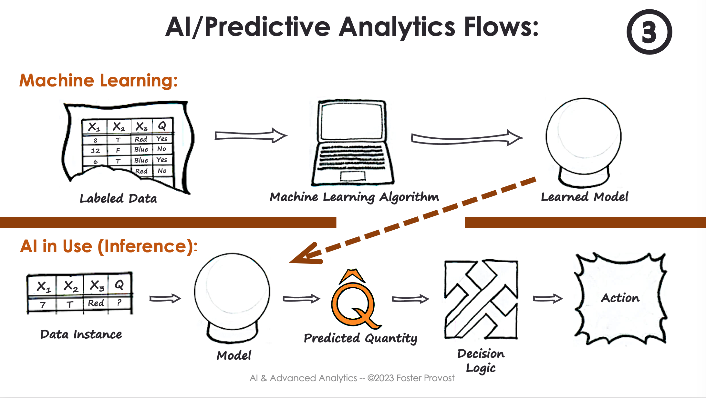

Where we are
So far
Again, make sure we have targets and features for all training instances

Slide 34

Where we are
So far
Train our model (sklearn.fit) to minimize loss function (or a regularized objective function)
This is machine learning!

Slide 35
Where we are
So far
We end with some learned model
(a trained linear/logistic regression/decision tree/ regression tree)

Slide 36
Where we are
So far
model.predict(X)

Slide 37
Where we are
So far
model.predict(X)
Gives us a prediction of the target (or for classification, a prediction of the probabilities for the target value)
For MegaTelCo – this could be:
Pr(Churn within a year | X)

Slide 38
Where we are
So far
model.predict(X)
Gives us a prediction of the target (or for classification, a prediction of the probabilities for the target value)
For MegaTelCo – this could be:
Pr(Churn within a year | X)
“Probability of churn within a year given features, x”

Slide 39
Where we are
So far
Almost always, we want to use DS/ML/AI to make better decisions!

Slide 40

Where we are
So far
Uh? Not too sure…
With Henrietta and MegaTelCo:
What we have so far,
Pr(Churn within a year | X)
Who really cares what this probability is?

Slide 41

Where we are
So far
With Henrietta and MegaTelCo:
What we have so far,
Pr(Churn within a year | X)
What we actually want to do?
Send out retention offers to minimize churn
How should we use this probability to make this decision? What factors about the offer and the customer (instance) are pertinent to this decision? Discuss!

Slide 42

Where we are
Today

Slide 43
Where we are
Business Understanding
Data Understanding
Today
Matrices:
Confusion Matrix
Cost Matrix
Curves:
ROC curve
Cumulative Response Curves
Lift Curve
Calibration Curve
Data Preparation
Data Science
Process
Deployment
Modeling
Evaluation

Slide 44
Notebook time!

